Slide 1
Data Analysis Bootcamp
Team Alpha
Celina Barrera
Francisco Eduardo Carmona
Alejandro Ochoa
Adrián Salinas
Alfonso Covarrubias

Slide 2
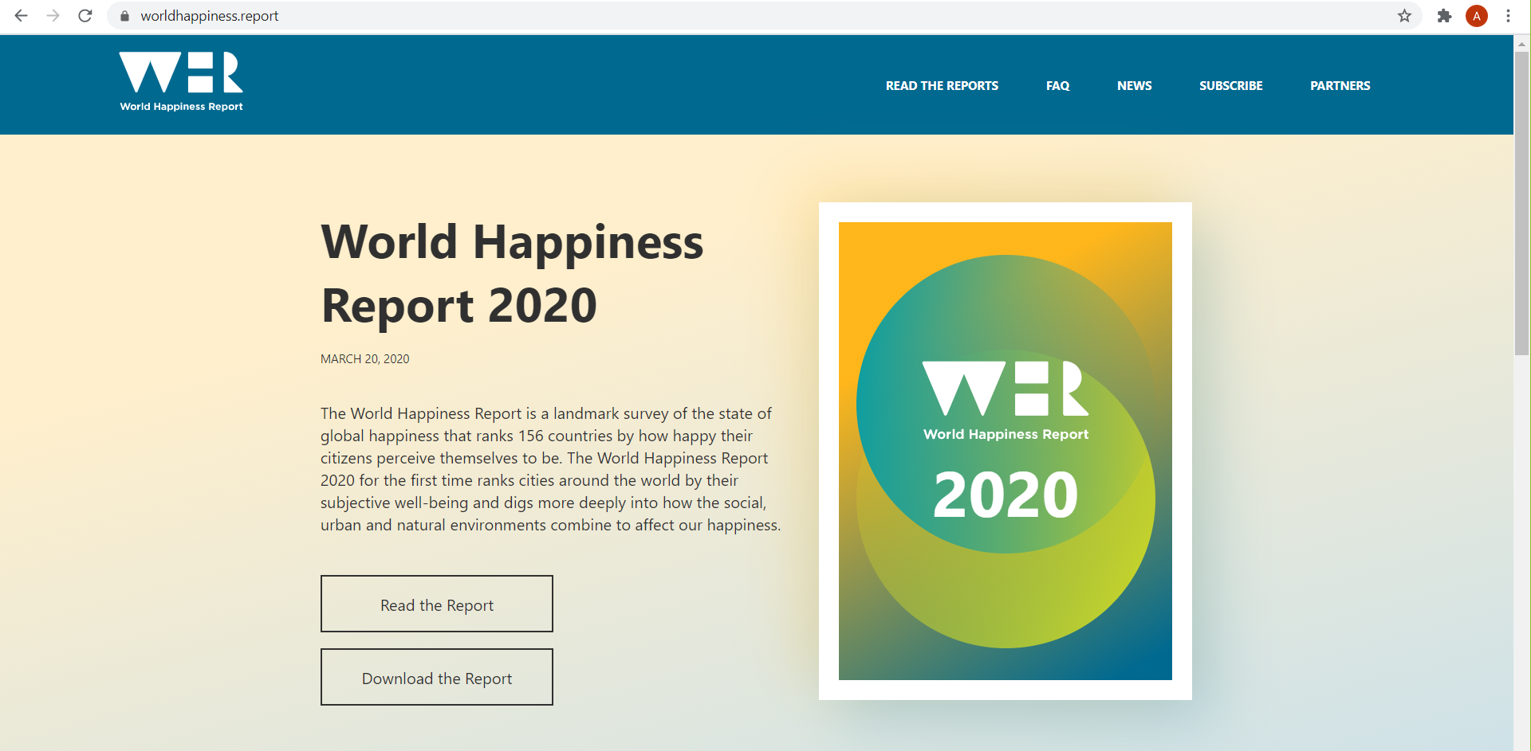
Data Source
Happiness score or subjective well-being (variable name ladder ): The survey measure of SWB is from the Feb 28, 2020 release of the Gallup World Poll (GWP).
GWP is a global analytics and advice firm that helps leaders and organizations solve their most pressing problems.

Slide 3
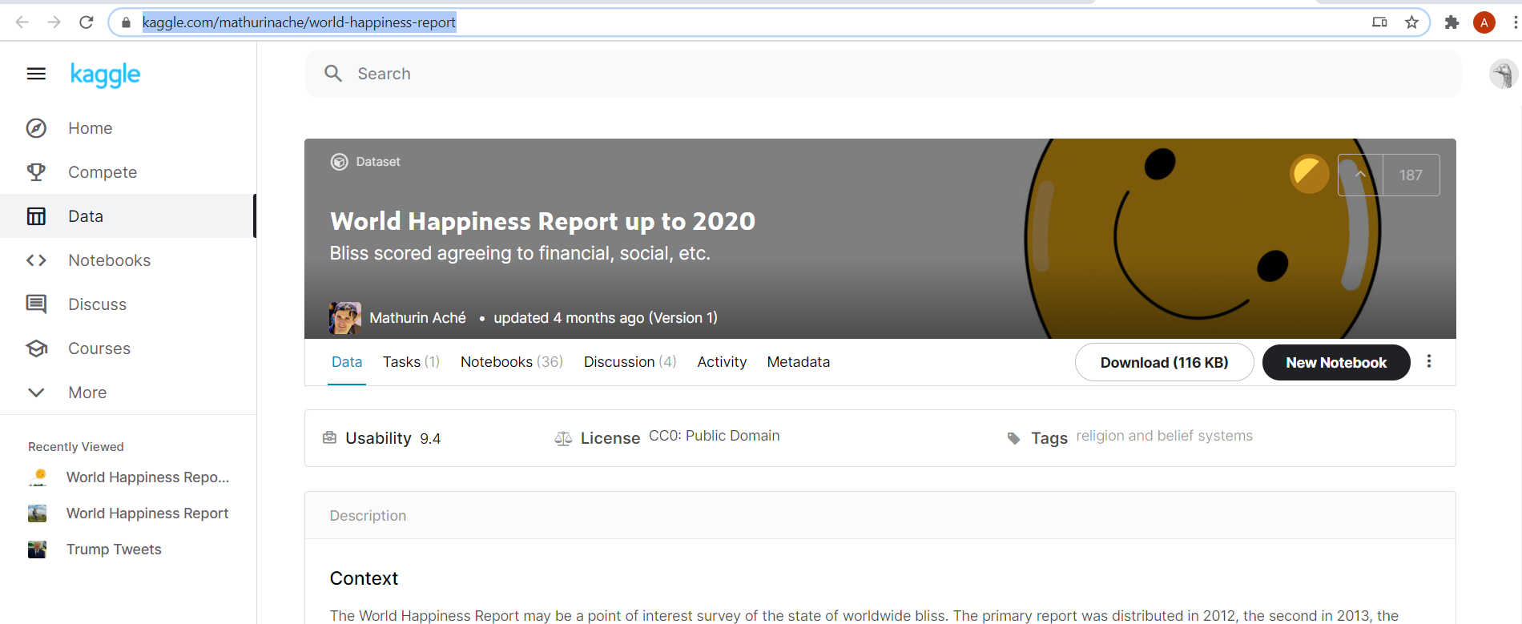
We specifically used kaggle to get the data:

Slide 4
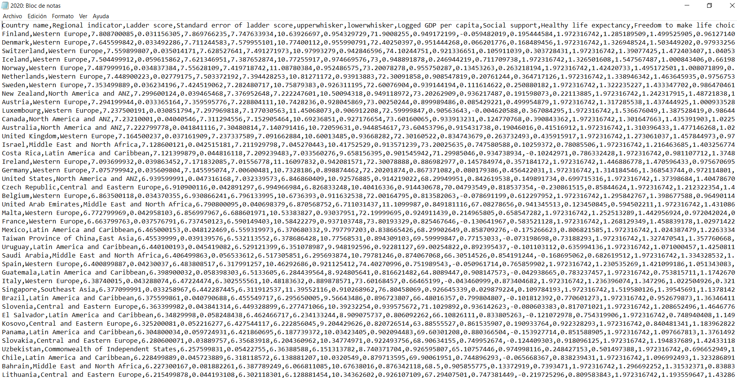

Slide 5
Variables to use
GDP
Healthy Life Expectancy
Social Support
Freedom to Make Life Choices
Generosity
Perceptions of Corruption

Slide 6
Variable Definitions
The statistics of GDP per capita (variable name gdp) in purchasing power parity (PPP) at constant 2011 international dollar prices are from the November 28, 2019 update of the World Development Indicators (WDI).
Healthy life expectancies at birth are based on the data extracted from the World Health Organization’s (WHO) Global Health Observatory data repository
Social Support (or having someone to count on in times of trouble) is the national average of the binary responses (either 0 or 1) to the GWP question “If you were in trouble, do you have relatives or friends you can count on to help you whenever you need them, or not?”
Freedom to make life choices is the national average of responses to the GWP question “Are you satisfied or dissatisfied with your freedom to choose what you do with your life?”
Generosity is the residual of regressing national average of response to the GWP question “Have you donated money to a charity in the past month?” on GDP per capita.
Corruption Perception: The measure is the national average of the survey responses to two questions in the GWP: “Is corruption widespread throughout the government or not” and “Is corruption widespread within businesses or not?” The overall perception is just the average of the two 0-or-1 responses.

Slide 7
What questions came up?
Which countries are the happiest?
How does Mexico rank?
How the variables correlate to the level of happiness of the countries
How does the happiness score is built?
Are there difference between years?
Does the correlation in a single variable change over the years?

Slide 8
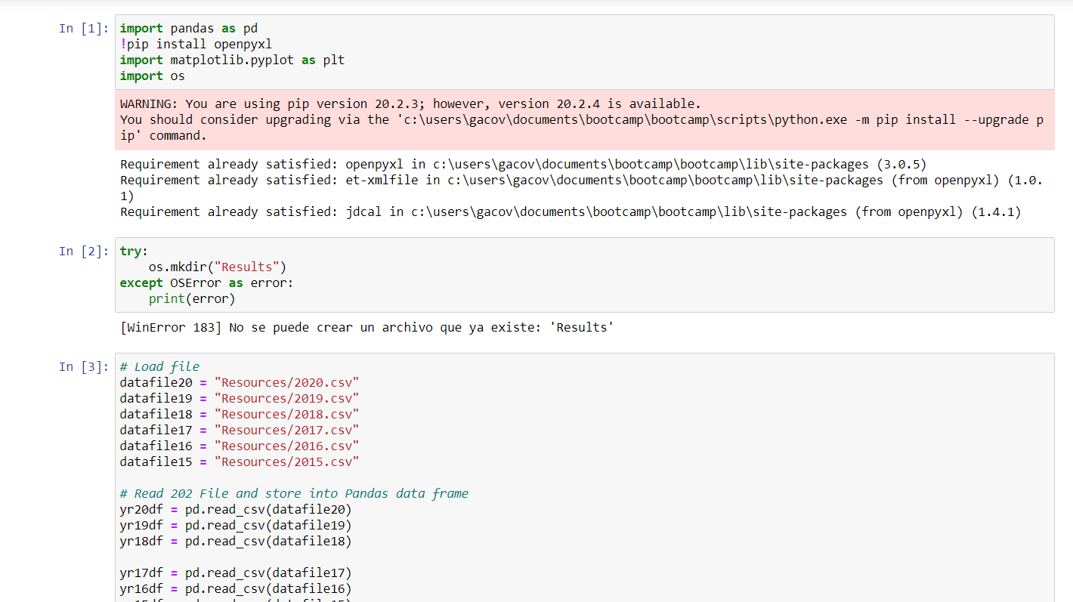
Data exploration and cleanup process

Slide 9
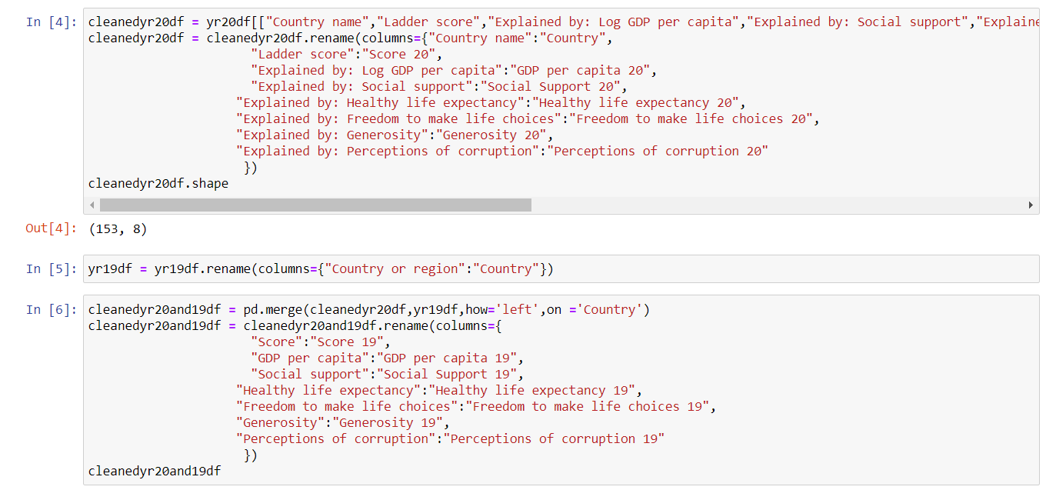
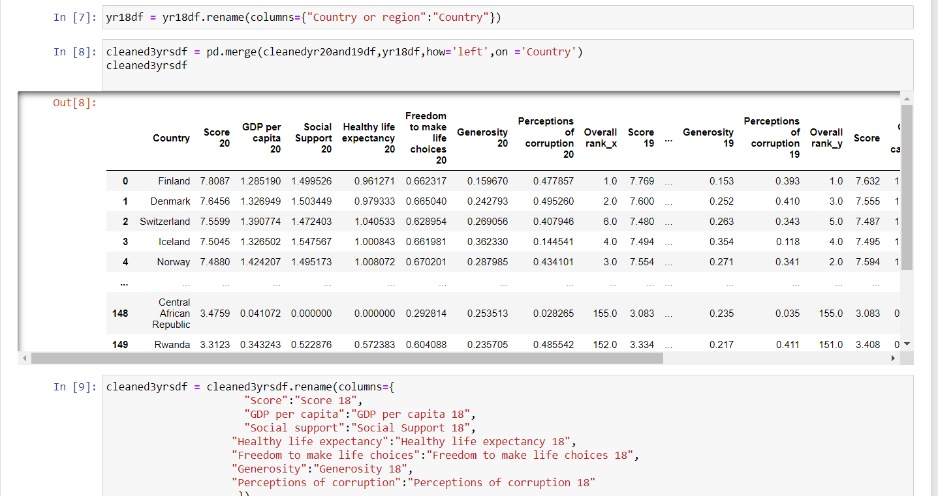

Slide 10
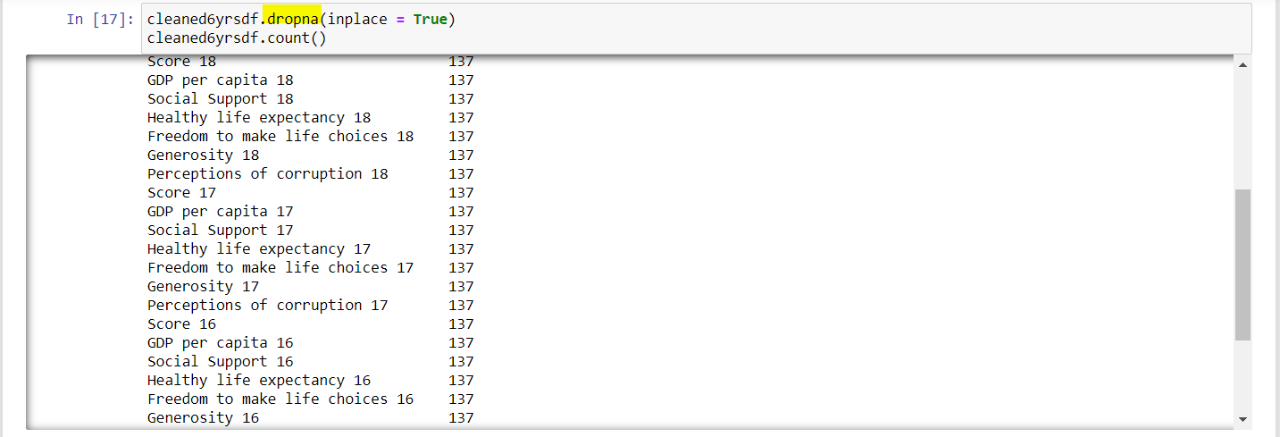
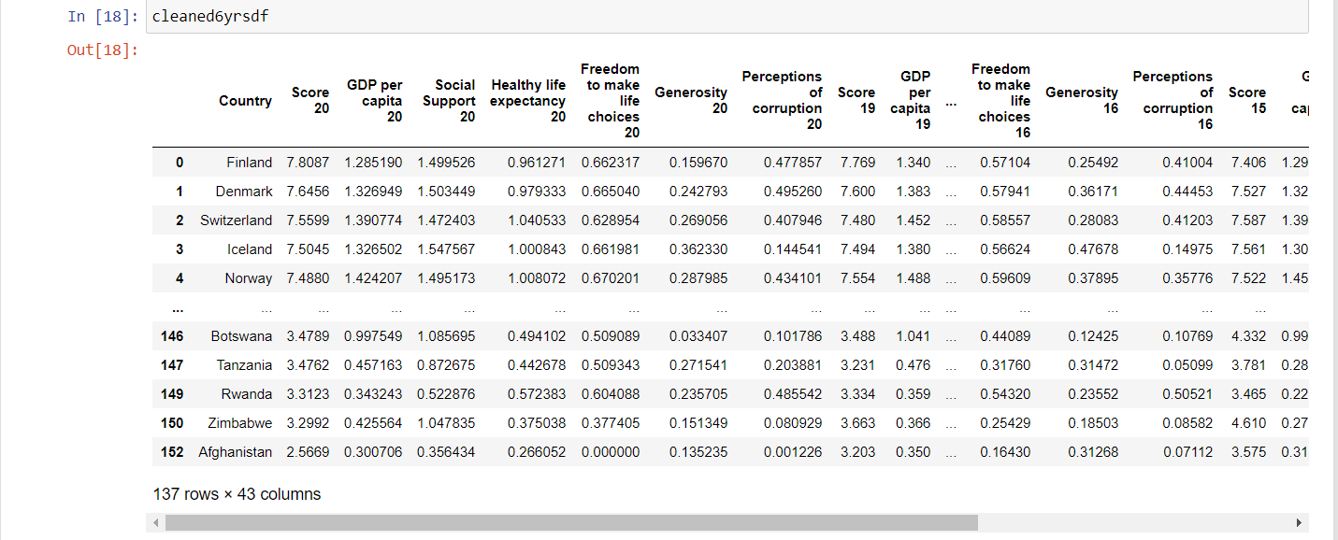

Slide 11
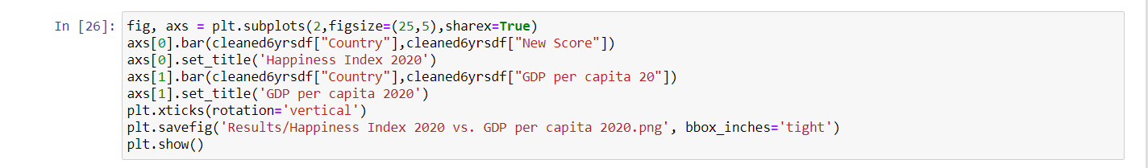
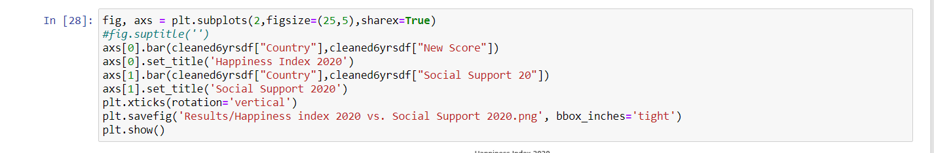
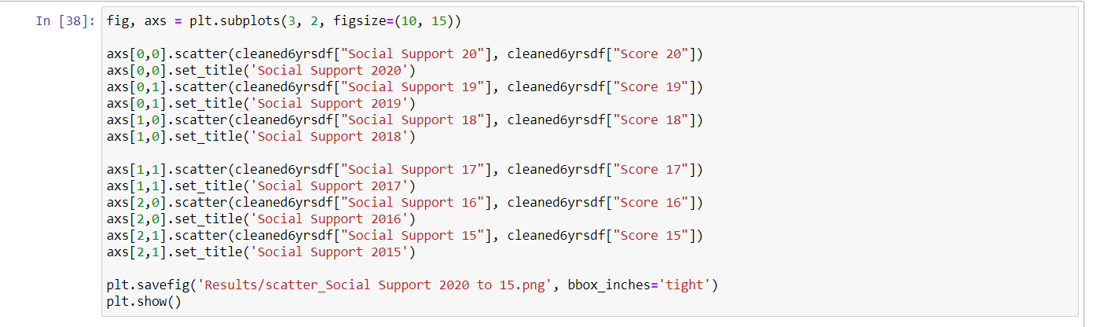
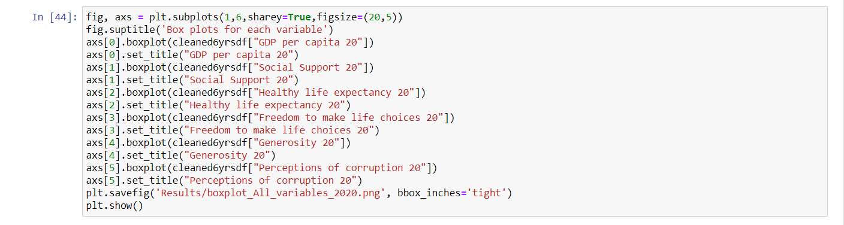
Analysis process

Slide 12
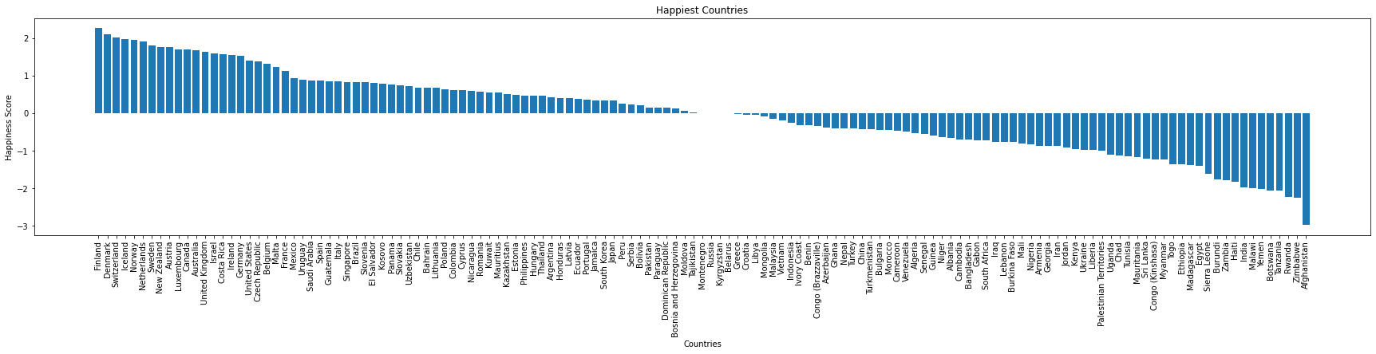
Data analysis process

Slide 13
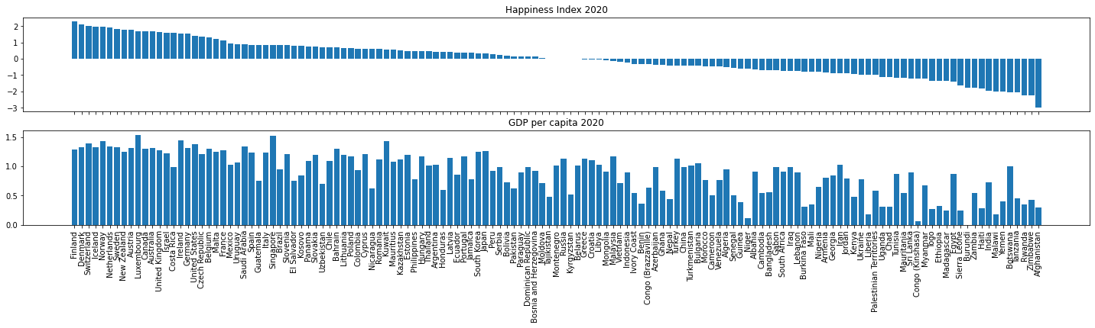
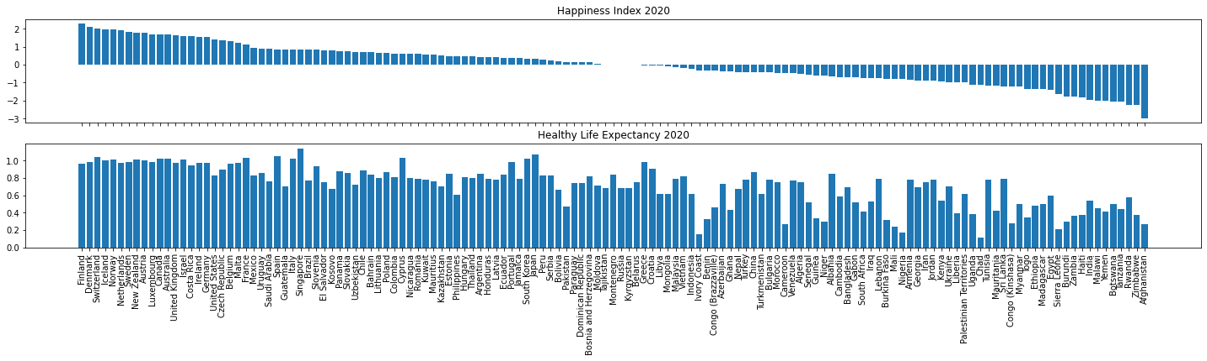

Slide 14
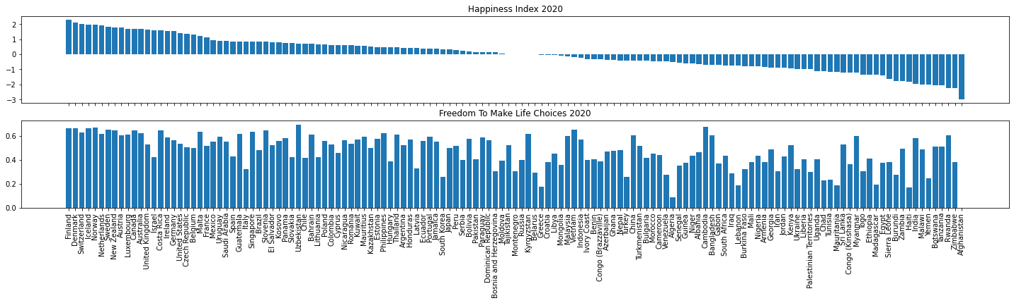
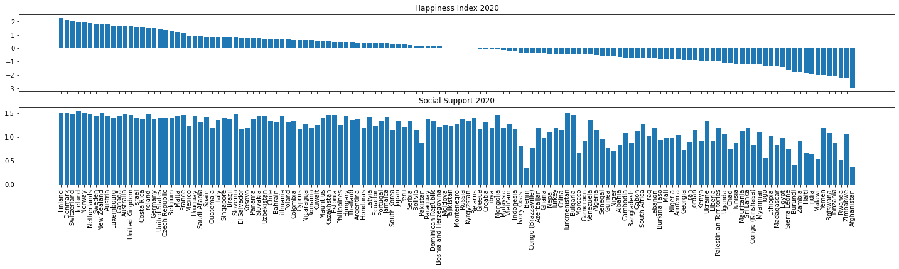

Slide 15
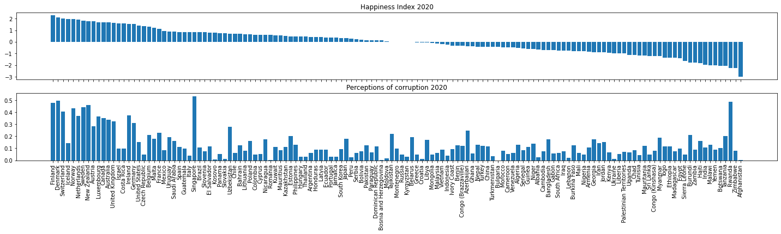
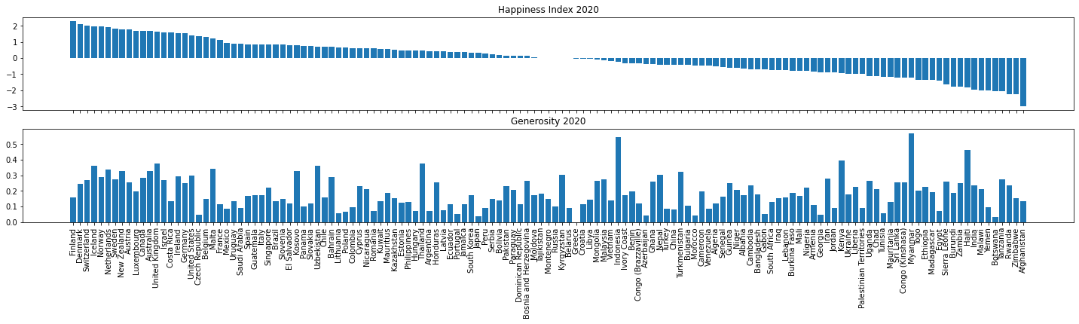

Slide 16
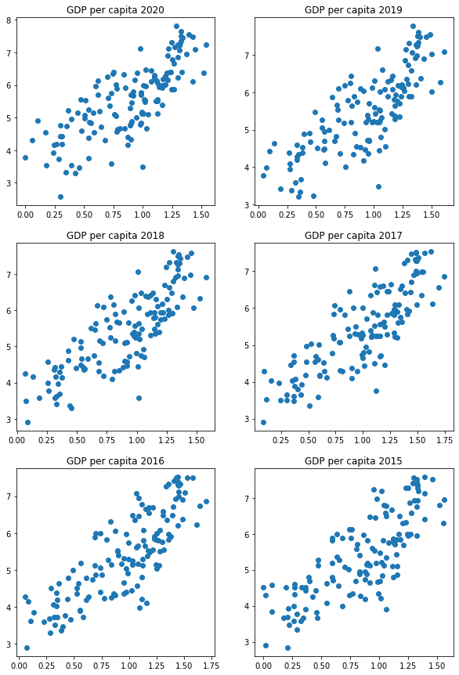
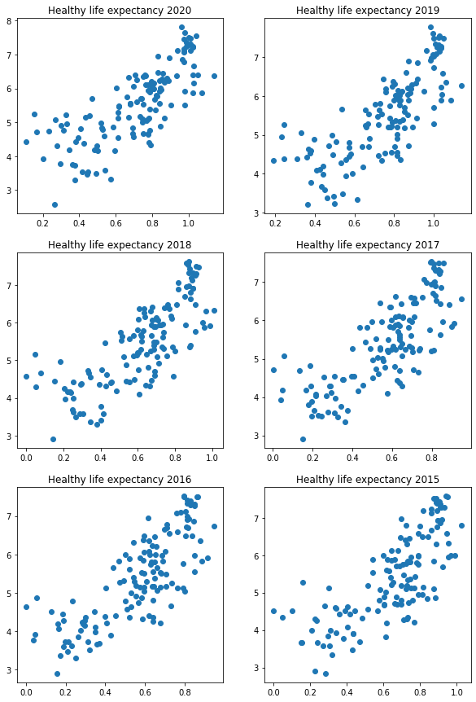
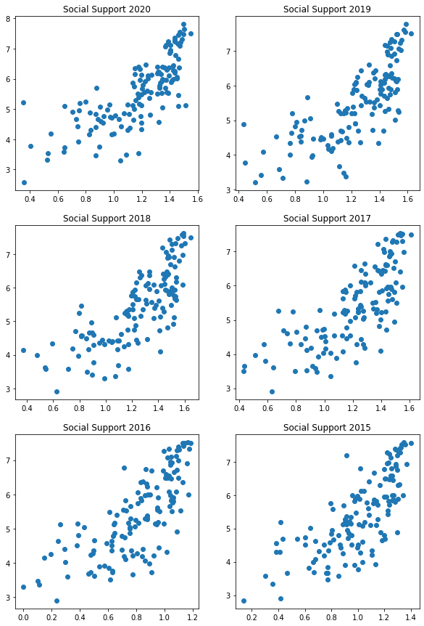
Findings

Slide 17
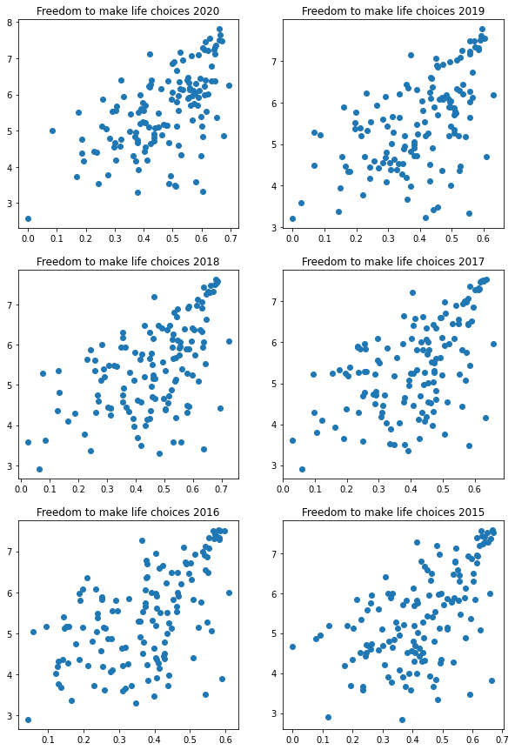
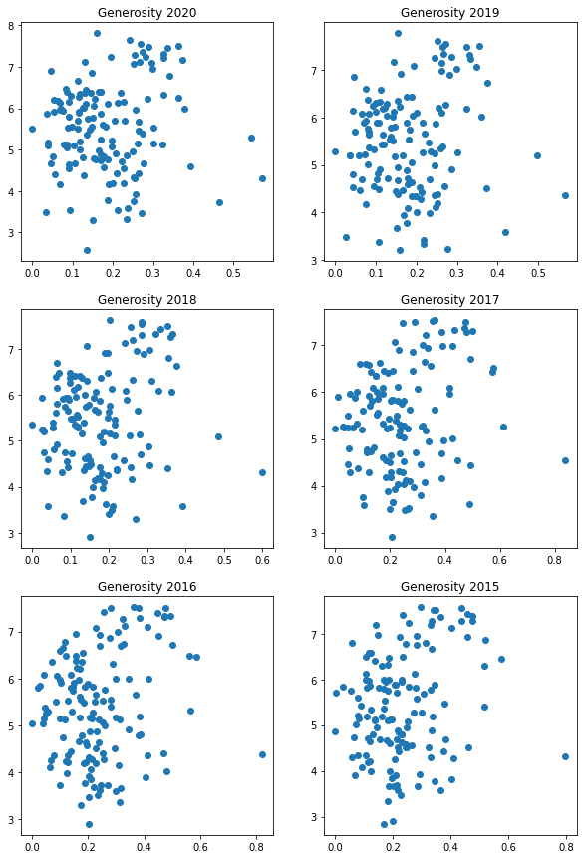
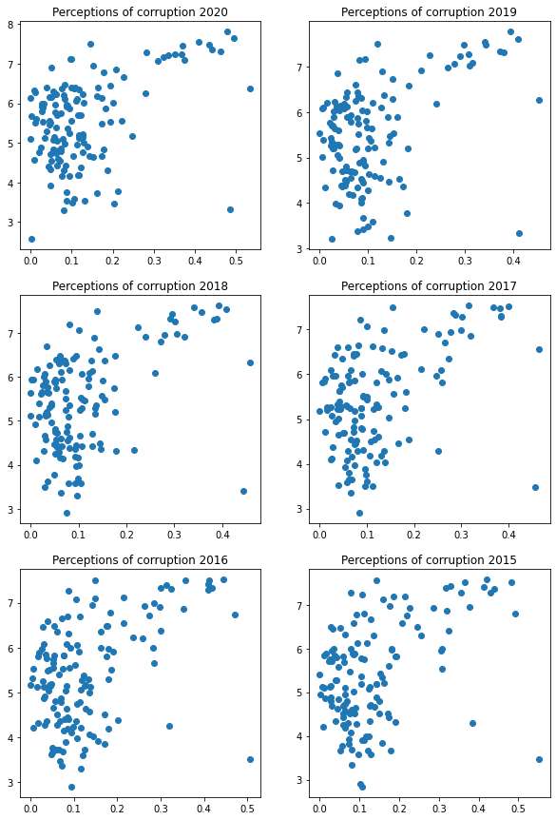

Slide 18
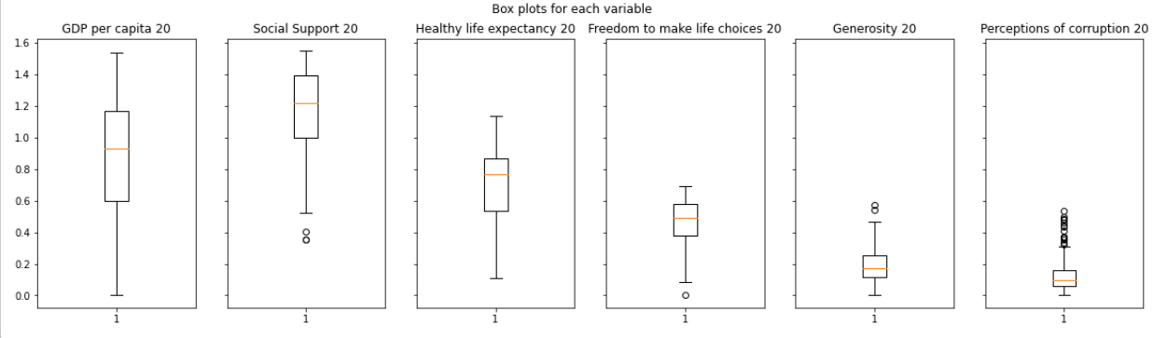

Slide 19
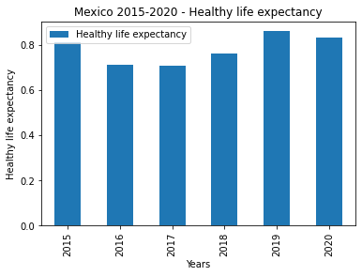
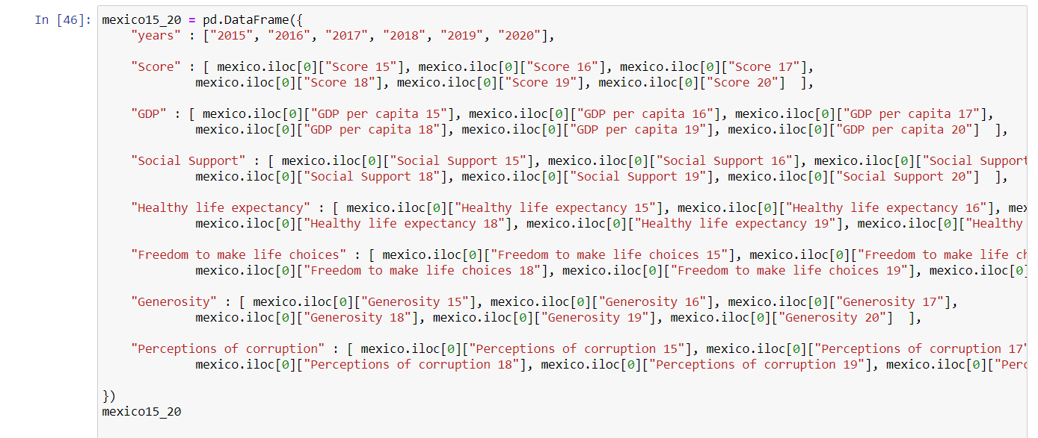
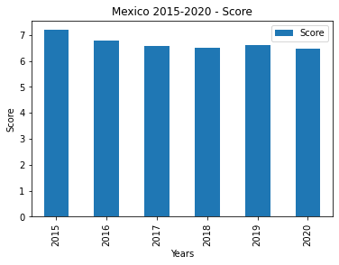
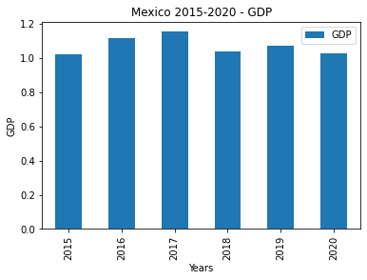
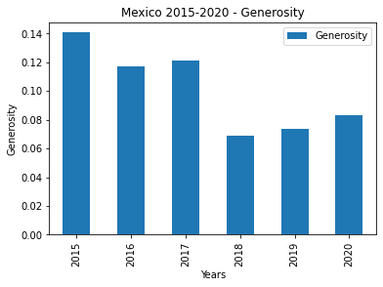
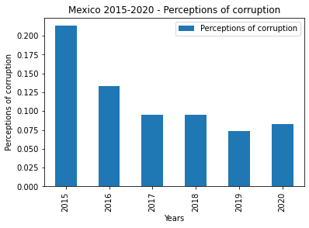
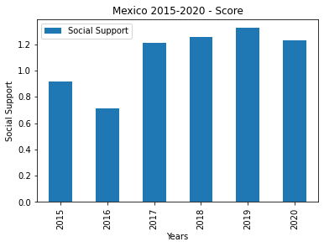
What about Mexico?

Slide 20
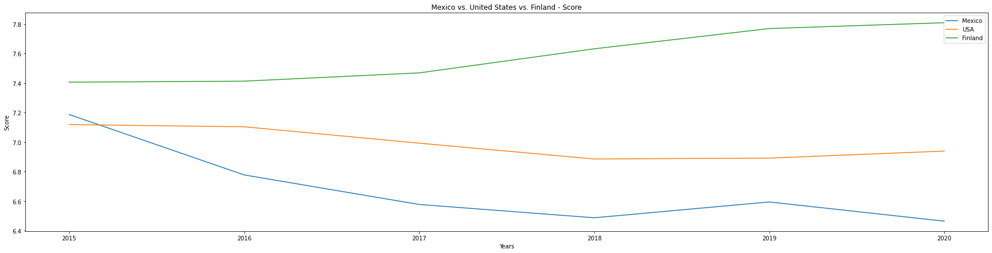
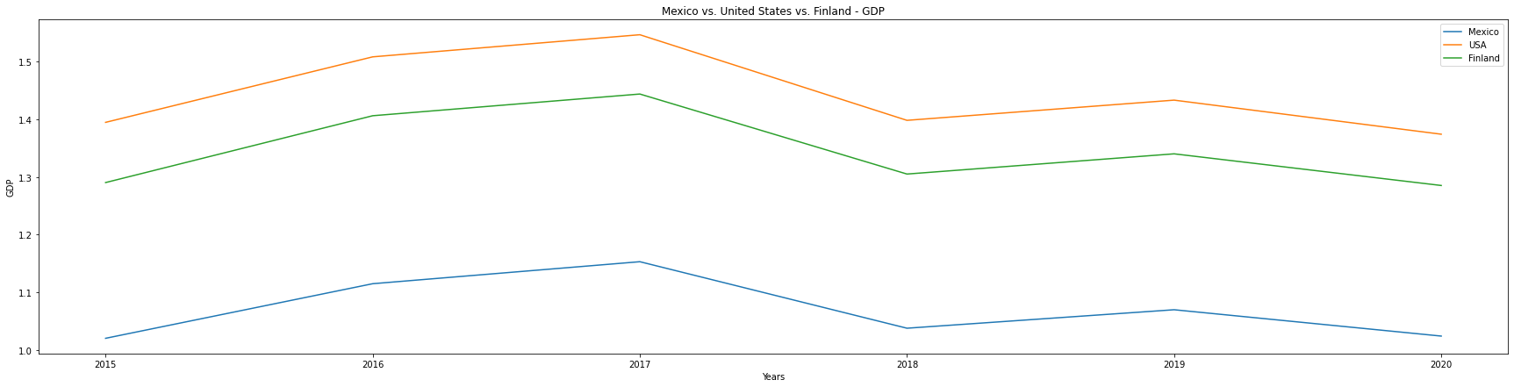

Slide 21
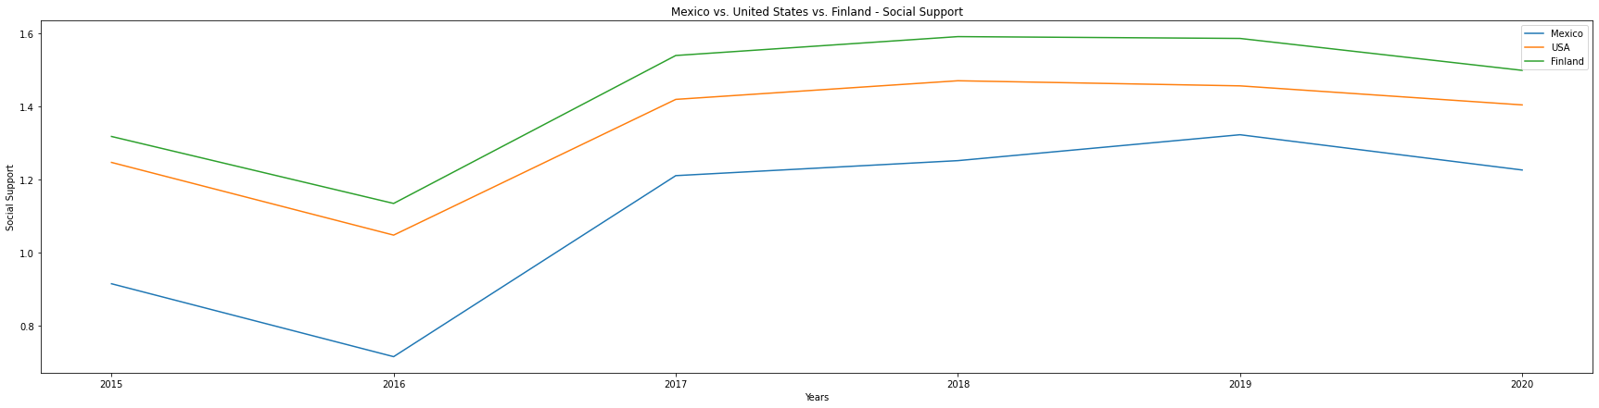
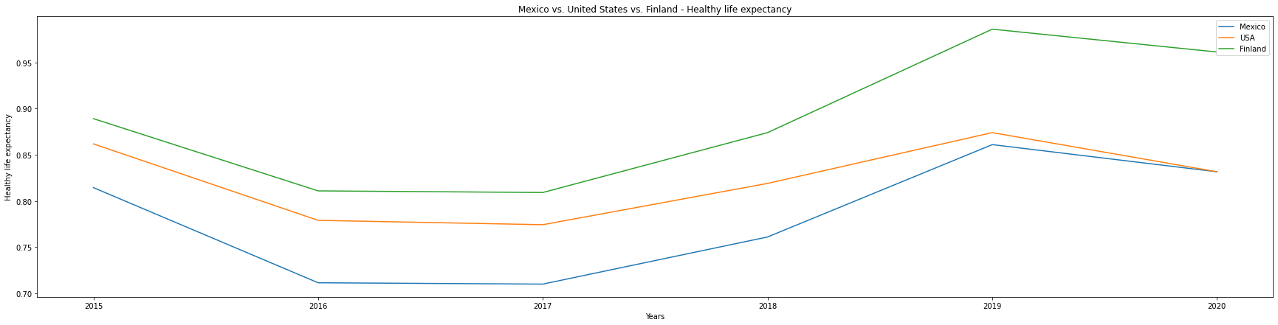

Slide 22
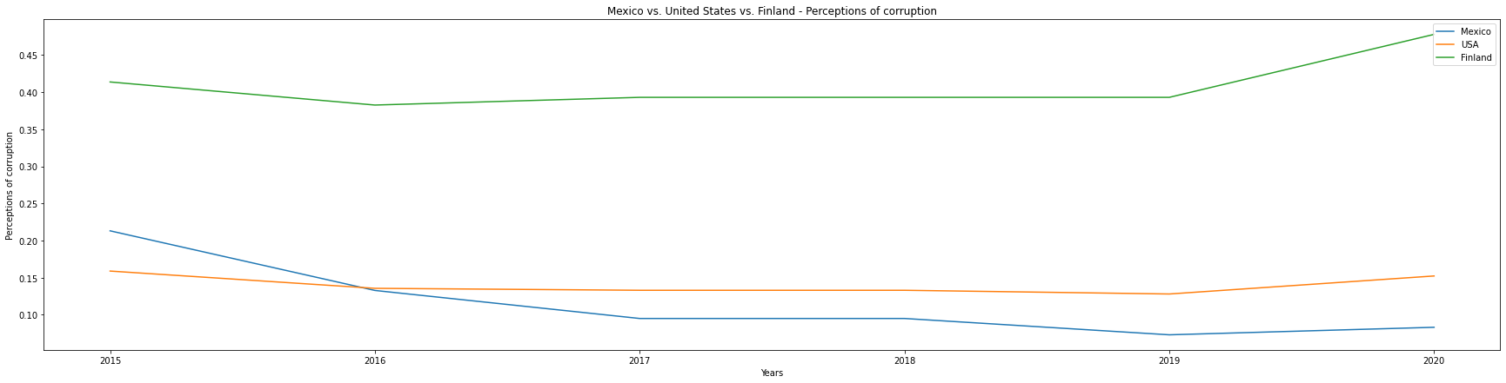
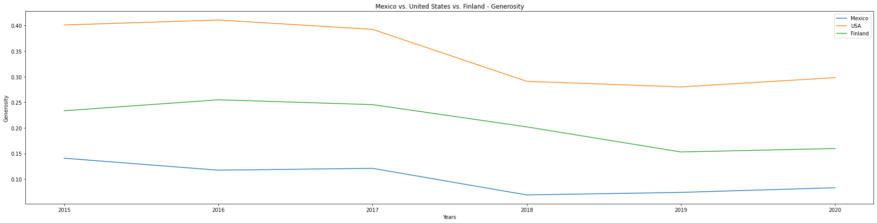

Slide 23
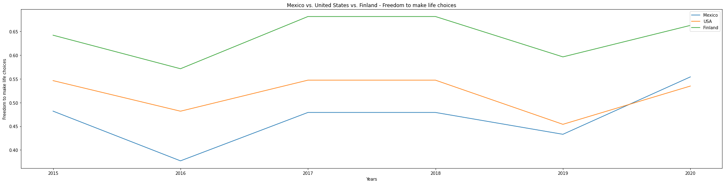

Slide 24
What we would suggest for next steps?
Further statistical analysis on the variables
Regression analysis to deep further in the interaction between variables
Perhaps this can be subject to machine learning for prediction analysis

Slide 25


